Slide 1
Introduction to Deep Learning
Bill Matthews (@Bill_Matthews)

Slide 2
Workshop Objectives
Workshop Objectives
Gain a conceptual (non-mathematical) understanding of what Deep Learning is and isn't
Understand how Deep Learning systems are developed
Train your own Deep Learning model to solve some problems
Explore the risks and challenges of testing Deep Learning based systems.
What to expect
You will Build and Train Models to solve some problems using small Standard Datasets
You don’t need to be able to code but you will be working with code through guided lessons
Working in groups to experiement with Models
We may not get through all the exercises
But you can always use the workbooks in your own time.
Support from be during the Workshop and after the workshop

Slide 3
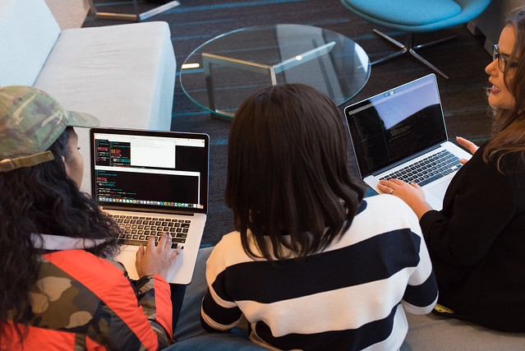
Workshop Pre-Requisites
You will need:
A Laptop (or access to shared one)
Internet Connection
A recent Chrome Browser installed
We are using a Google Colab platform so other browsers might not work that well
A Google Account that you can access
You will need this to access the Google Colab platform
Image courtesy of wocintechchat.com

Slide 4
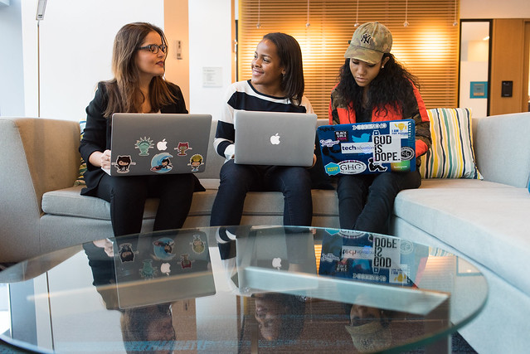
Form Up!
Form Teams of between 2 and 5
Introduce yourselves to each other
Agree on an Awesome Team Name
Put your Team Name on the Teams Sheet
If you are waiting for others to finish forming a team then discuss in your team
Your current knowledge of AI, Machine Learning and Deep Learning
What you want to get out of this session
Image courtesy of wocintechchat.com

Slide 5
AI, ML, DL oh my!
Artificial Intelligence
Artificial Intelligence (AI) – Broad Field of Scientific Study
Computational Intelligence and Decision Making
Machine Learning (ML) - An approach to AI where an algorithm learns from examples and/or experience
Supervised – learn from examples and expected outcomes
Unsupervised – learns patterns and relationships from data without expected outcomes
Reinforcement – learns from experiences via immediate or delayed reward signal
Deep Learning
An approach to Machine Learning that uses Deep Neural Networks to approximate some relationship between a set of input and an output
Machine Learning
Deep Learning

Slide 6
What Deep Learning Does
Observation
Target
Some Relationship
Learns to approximate this Relationship
Deep Learning Model

Slide 7
How does it learn (supervised learning)
Data
Deep Learning Model
Targets
(Expected Outputs)
Loss Function
Loss
Predictions
Observations
(Inputs)
Model
Parameters

Slide 8
What does the Model look like
Input Layer
Hidden Layers
Output Layer
Observations
Predictions

Slide 9
Developing Intution about how Deep Learning works
Access the Github Repository at
https://github.com/BillMatthews/DeepLearningIntro
Click on the link to “Lesson 1 - Developing DL Intuition”
This *should* open up the workbook in Colab

Slide 10
So what can we do with Deep Learning?
We can Predict things
Given a set of inputs and a set of expected outputs, Deep Learning can learn to approximate the mapping between the two and generalise to new inputs to estimate the predicted output.
Predict when a customer will leave
Predict Weather or Climate conditions
Predict the cost of something
Predict when an event is likely to happen
Assumes there is some relationship between the inputs and outputs

Slide 11
So what can we do with Deep Learning?
We can Classify things
Based on a set of inputs and a pre-defined set of classifications, Deep Learning can approximate the rules used to classify the inputs as one (or more) of the classifications.
Object Detection
Object Recognition
Meaning and Sentiment
Assumes there is some set of rules that would allow the inputs to be classified.

Slide 12
Predicting Stuff – Image Prediction
Access the Github Repository at
https://github.com/BillMatthews/DeepLearningIntro
Click on the link to
Lesson 2 - Making Predictions
This *should* open up the workbook in Colab

Slide 13
Classifying Stuff – Image Classification
Access the Github Repository at
https://github.com/BillMatthews/DeepLearningIntro
Click on the link to
Lesson 3 - Image Classification Part 1
This *should* open up the workbook in Colab

Slide 14
Classifying Stuff – Image Classification
Access the Github Repository at
https://github.com/BillMatthews/DeepLearningIntro
Click on the link to
Lesson 4 - Image Classification Part 2
This *should* open up the workbook in Colab

Slide 15
Classifying Stuff – Text Classification
Access the Github Repository at
https://github.com/BillMatthews/DeepLearningIntro
Click on the link to
Lesson 5 – Text Classification
This *should* open up the workbook in Colab

Slide 16
Testing Deep Learning Systems
Consider the following Pedestrian Detection System on a Vehicle
It takes 20 frames a second from a high definition front facing camera
A Deep Learning System is used to process the camera frame to detect the presence of a person (in front of the vehicle)
If it detects a person, it sends a message with location information to a Pedestrian Avoidance System.
During Training of the Deep Learning System we achieved 98% accuracy against our Test Set.
In your Teams and based on what you know about training and testing Deep Learning Systems:
Do you think 98% Accuracy is good enough?
Identify a set of risks that you’d want to specifically test
How would you test for those risks to identify potential issues

Slide 17
Transfer Learning (Optional)
Access the Github Repository at
https://github.com/BillMatthews/DeepLearningIntro
Click on the link to
Lesson 6 – Transfer Learning
This *should* open up the workbook in Colab

Slide 18
Well Done!
You’ve come a long way in a short time
What Deep Learning is and isn’t
What a Neural Network conceptually looks like and how it learns
Practiced building models to solve problems
Evaluated and Tested Deep Learning Models
Further Resouces to continue your journey
see the Further Resource PDF on GitHub
Feel free to reach out to me

Slide 19

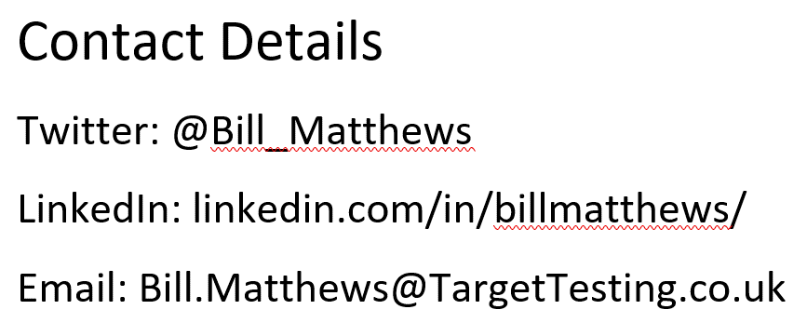
Question Time
Any questions?
Ask now
Ask later
Ask Online
Image courtesy of wocintechchat.com

